Slide 1

CSE 464 : Software Quality Assurance and Testing
What is Software Quality – Part 2
Janaka Balasooriya

Slide 2
Ajenda
Defects and Software Quality
Quality assurance
Software testing (Why do we test? and What do we test?)
Reading Assignment

Slide 3
Software Defects and Quality
Defect (or Bug): is a problem with the software, either with its external behavior or with its external characteristics.

Slide 4
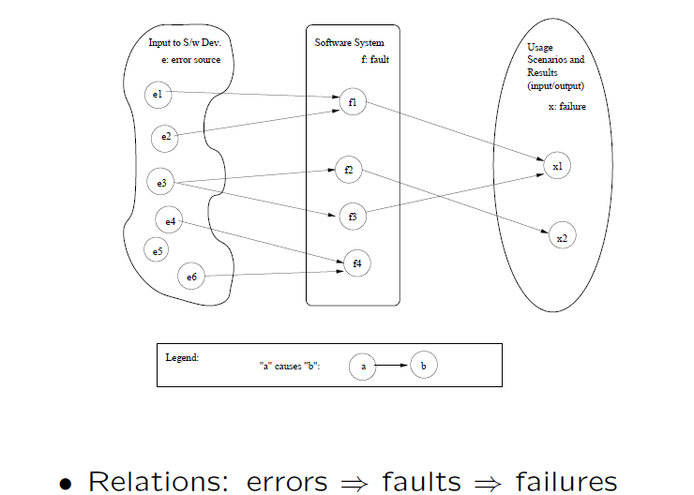
Correctness, Defects (Bugs) and Quality
Good Quality = > Less Defects
Error, Fault, and Failure [1]

Slide 5
Error, Fault, and Failure
Error : A human action that produces an incorrect result
Fault: An incorrect step, process, or data definition in a program/ design/other software engineering artifact.
Failure: The inability of a system or a component to perform its required functions within specified performance requirements
Defect (or Bug): is a problem with the software, either with its external behavior or with its external characteristics. Defect is an instance of a failure.
if(x < 5)
cout<< “X is 5 or less;
else
cout<<“X is greater than 5”;

Slide 6
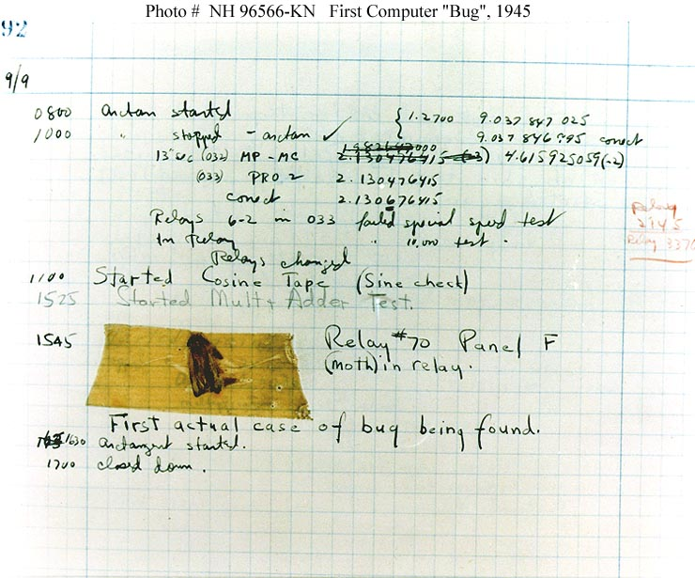
The First Computer Bug?
In 1947, Grace Murray Hopper was working on the Harvard University Mark II Aiken Relay Calculator (a primitive computer).
On the 9th of September, 1947, when the machine was experiencing problems, an investigation showed that there was a moth trapped between the points of Relay #70, in Panel F.
The operators removed the moth and affixed it to the log. The entry reads: "First actual case of bug being found.“
The word went out that they had "debugged" the machine and the term "debugging a computer program" was born.
http://www.history.navy.mil/photos/images/h96000/h96566kc.htm

Slide 7
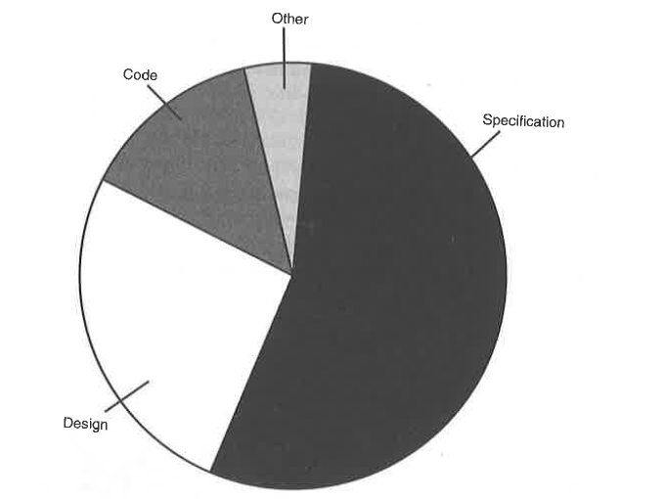
Bugs are coming from ….

Slide 8
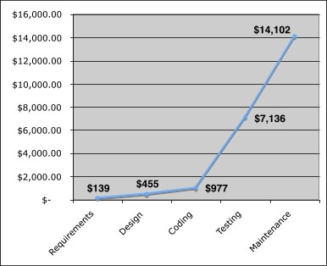
Cost of Defect (Bug) Identification and Repair
The relative costs to find and repair an error or defect increase dramatically as we go from prevention to detection to internal failure to external failure costs.
Taken from “Software Testing” by Ron Patton

Slide 9
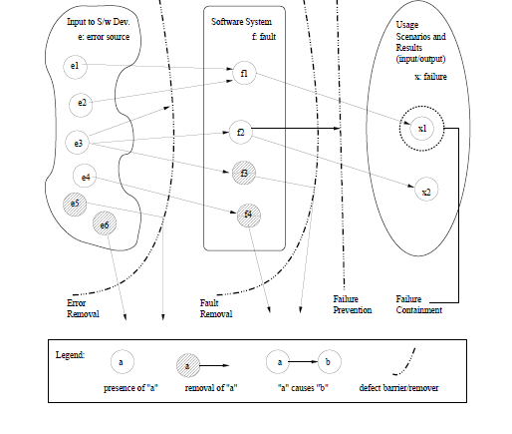
Software Quality Assurance: Towards High Quality Software
Three generic categories
Defect Prevention :
Avoid error sources
Defect Reduction:
Software Inspection, Testing,
Risk management
Defect Containment:
Software fault tolerance …etc
Software Quality Assurance Stages [1]

Slide 10
Software Quality Assurance Stages
Software QA as dealing with defects
  Defect prevention through error blocking
    Mitigating human errors by education and training (Product and domain specific knowledge, software development knowledge, knowledge about development methodology, technology and tools, development process knowledge)
    Better manage software process
    Using appropriate tools
    Using better software design/architecture
  Defect reduction through fault detection and removal
    Inspection (code/design/requirement/test plan/test cases … etc)
    Testing : Failure observation and fault removal
  Defect containment through failure prevention and containment
    Software fault tolerance (Executing the recovery block repeatedly, Duplication/parallel redundancy)

Slide 11
Software Life Cycle Models and Quality Assurance
Software life cycle for a particular project depends on the nature of the project deliverables, time lines, resources available, completeness of requirements …etc
Major categories of software life cycle models are Waterfall, Incremental, Iterative, Agile
Aligning the SQA techniques with the software life cycle model used to develop the software is imperative in ensuring high quality software product.
Investigating software quality assurance activities in the waterfall model allows us to get a better perspective

Slide 12
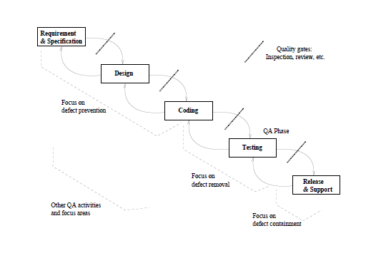
Quality Assurance Activities in the Waterfall Model

Slide 13
Quality Assurance Activities in the Waterfall Model
defect prevention in early phases
  Error sources are associated with early phases
  Inspections and reviews can be used to detect and remove error sources
focused defect removal in testing phase
defect containment in late phases
phase transitions:
  Inspection, review…etc except from testing to release.
  From testing to release its acceptance testing

Slide 14
Quality Assurance Activities in Other Process Models will be discussed later in the semester

Slide 15
Defect Repair Cost : Lion King CD-ROM Example
Defect Prevention:
The root cause of the problem was that the software did not work on a popular PC platform. How they could have eliminated the root cause?
Defect Reduction:
If the defect prevention did not happen, how testers could have identified the defect?
Defect Containment:
How Disney might have handled this?

Slide 16
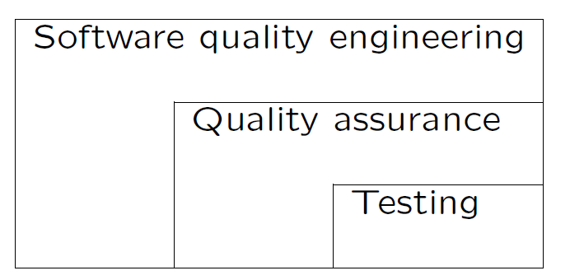
Software Quality Assurance and Testing
Software Testing is the most important part of QA and the most commonly performed QA activity
What do we test?
In broader sense, we test if the software does the right thing and the software does the things right.
  Does the right thing : based on the specification of the software
  Does the thing right: perform specific tasks correctly and satisfactory
Software Quality vs. Testing [1]

Slide 17
Why Do We Need Testing (Can we hire perfect software eng/programmers?
Watts S. Humphrey at CMU conducted a study of 13000 programs and concluded that “on average professional coders make 100 to 150 errors in every thousand line of code they write”.
Reading assignment (posted with week 1 lectures): Why Software is So Bad, By Charles C. Mann, Technology Review, June 27, 2002

Slide 18
Homework: Reading Assignment
Quality Assurance : Chapter 2 from
[1] Software Quality Engineering: Testing, Quality Assurance, and Quantifiable Improvement, Jeff Tian, ISBN: 978-0-471-71345-6, Wiley-IEEE Computer Society Press

